Slide 1
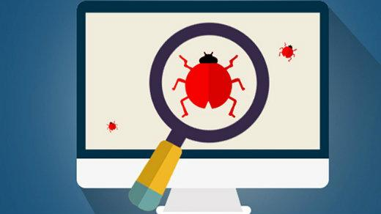
Bug Tracking System
Team:-
Debug dominators

Slide 2
Team Members
Anuja Jadhav
Tejas patil
Aishi dey
Ashwaq khazi
Vandita
Pratiti hazra
Rishabh parmar

Slide 3
UI SnapShots

Slide 4
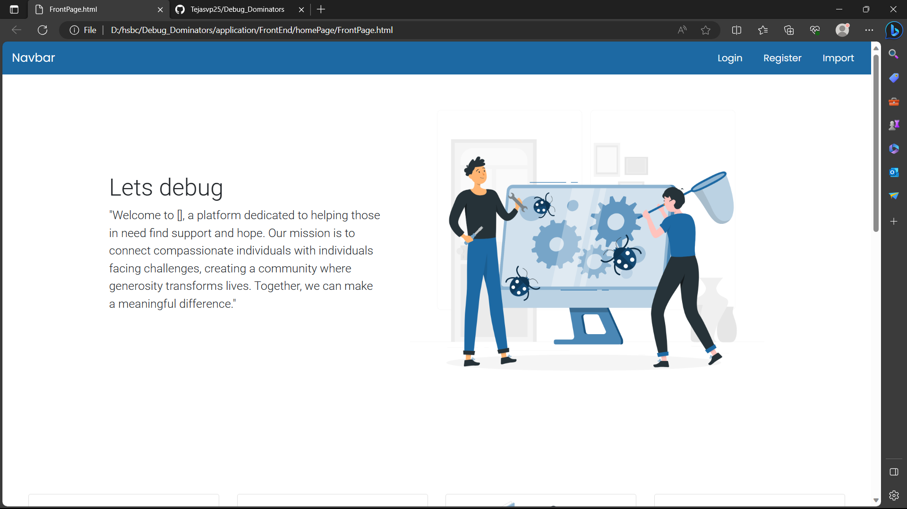

Slide 5
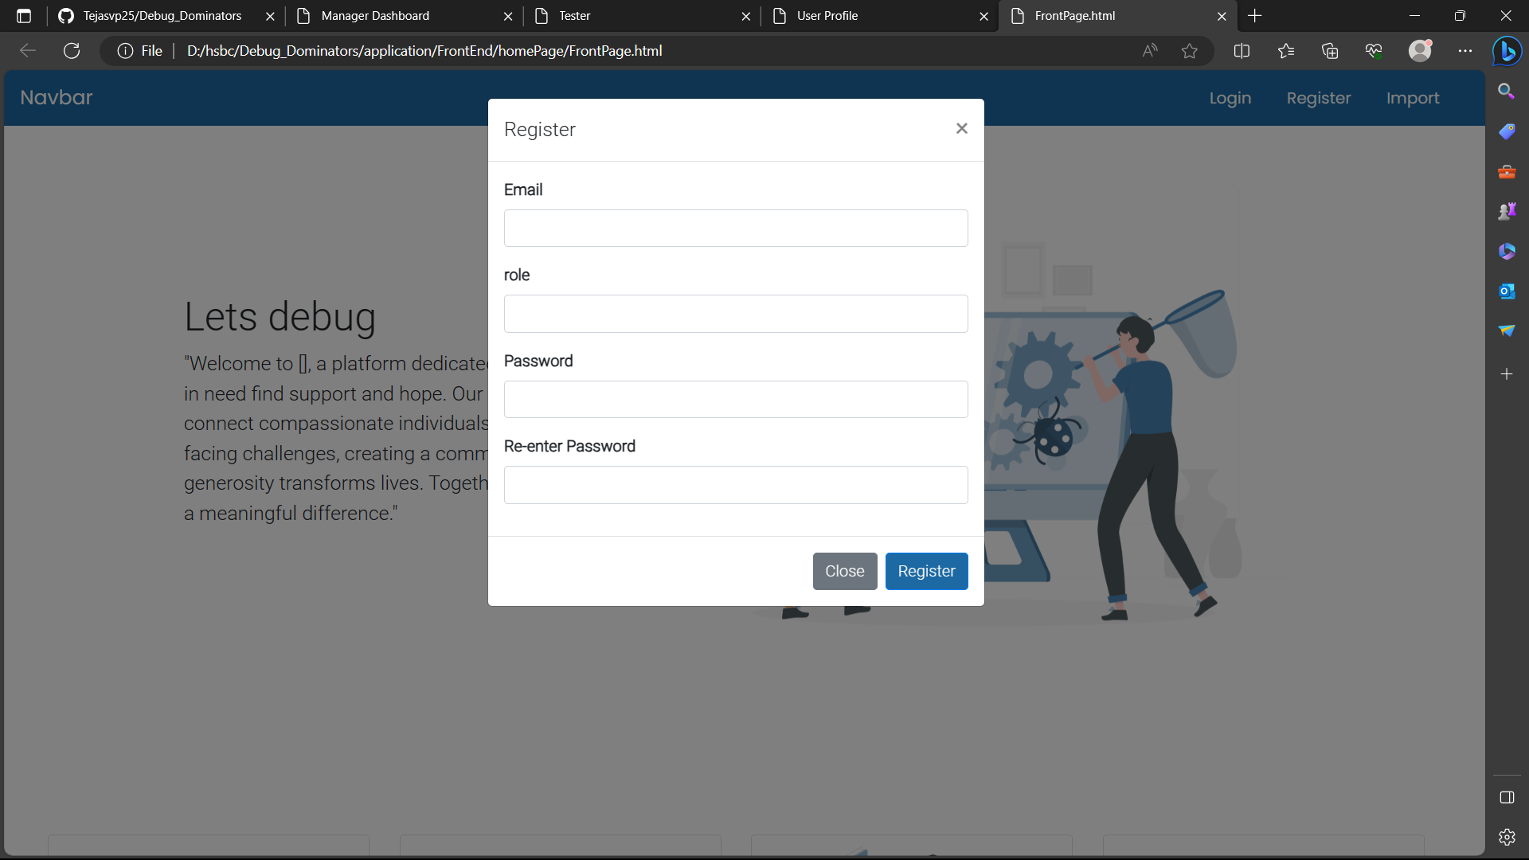

Slide 6
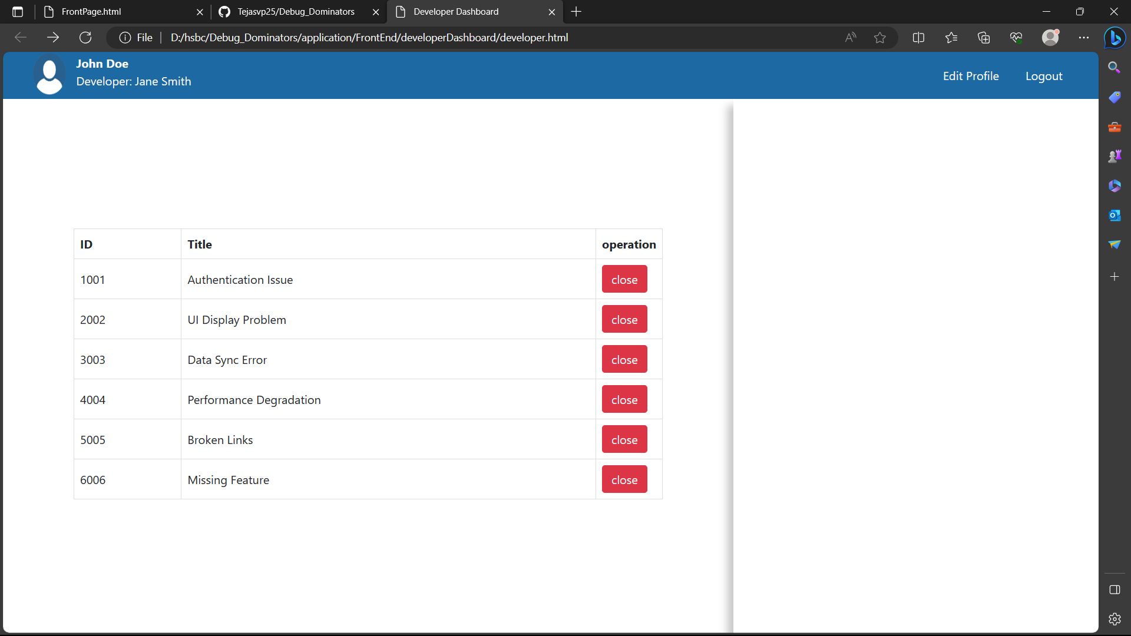

Slide 7
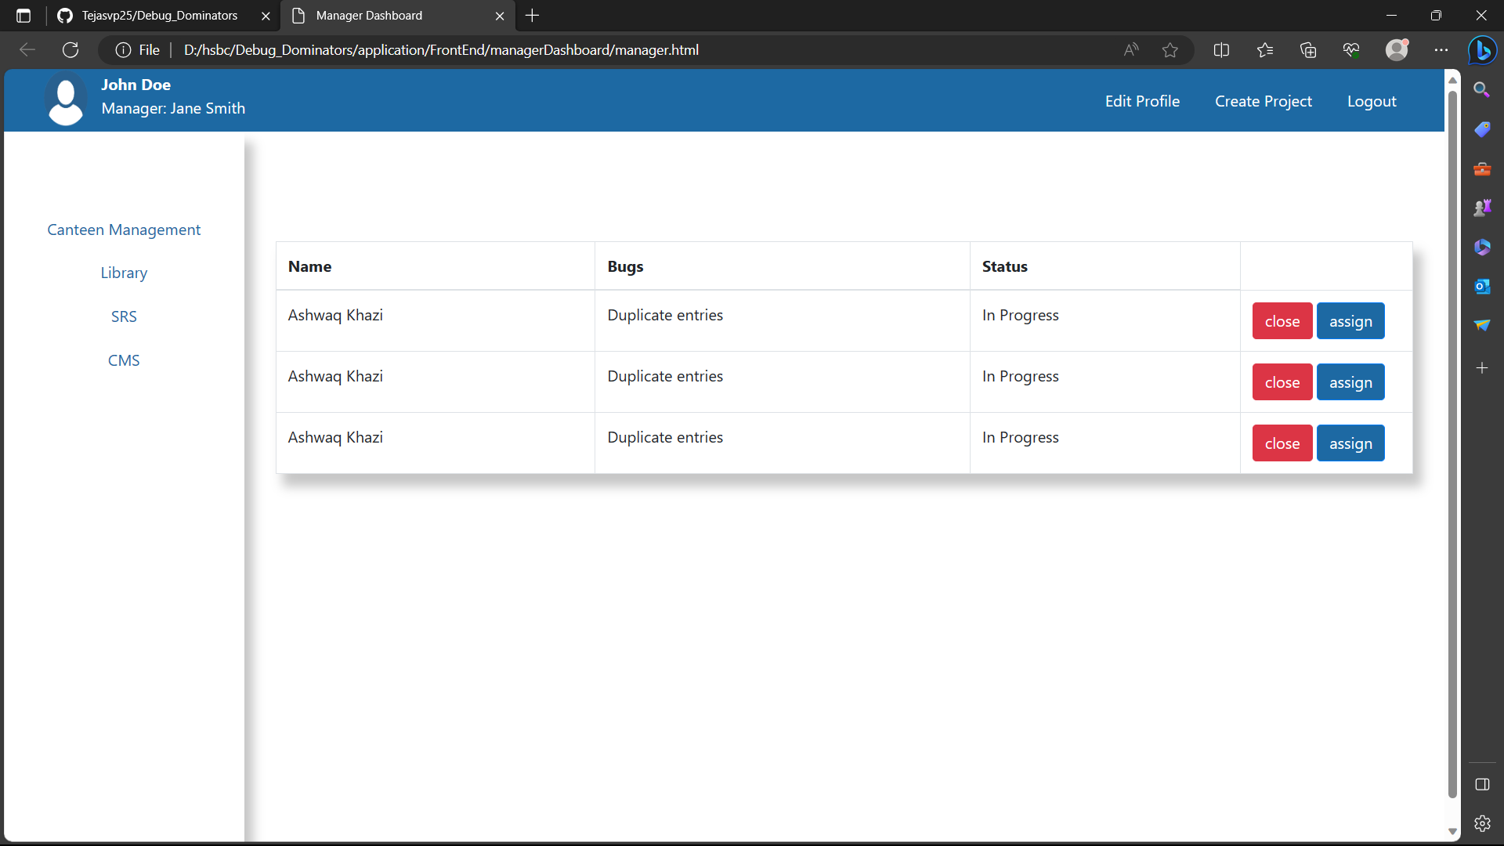

Slide 8
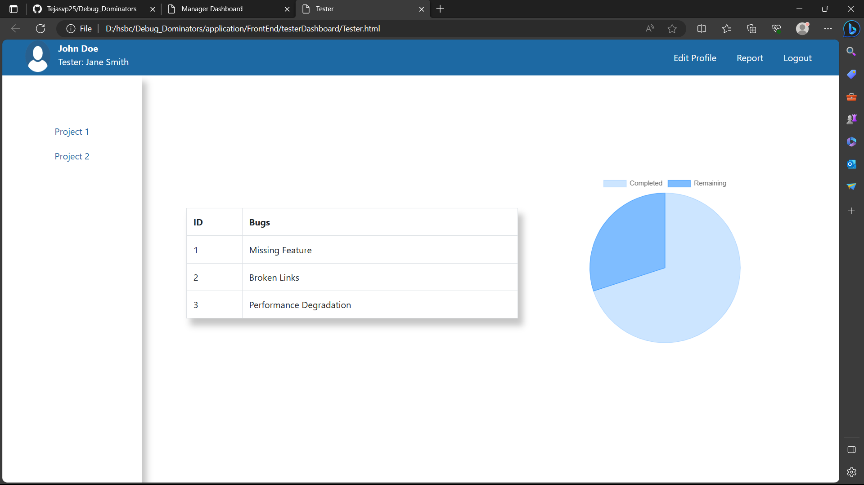

Slide 9
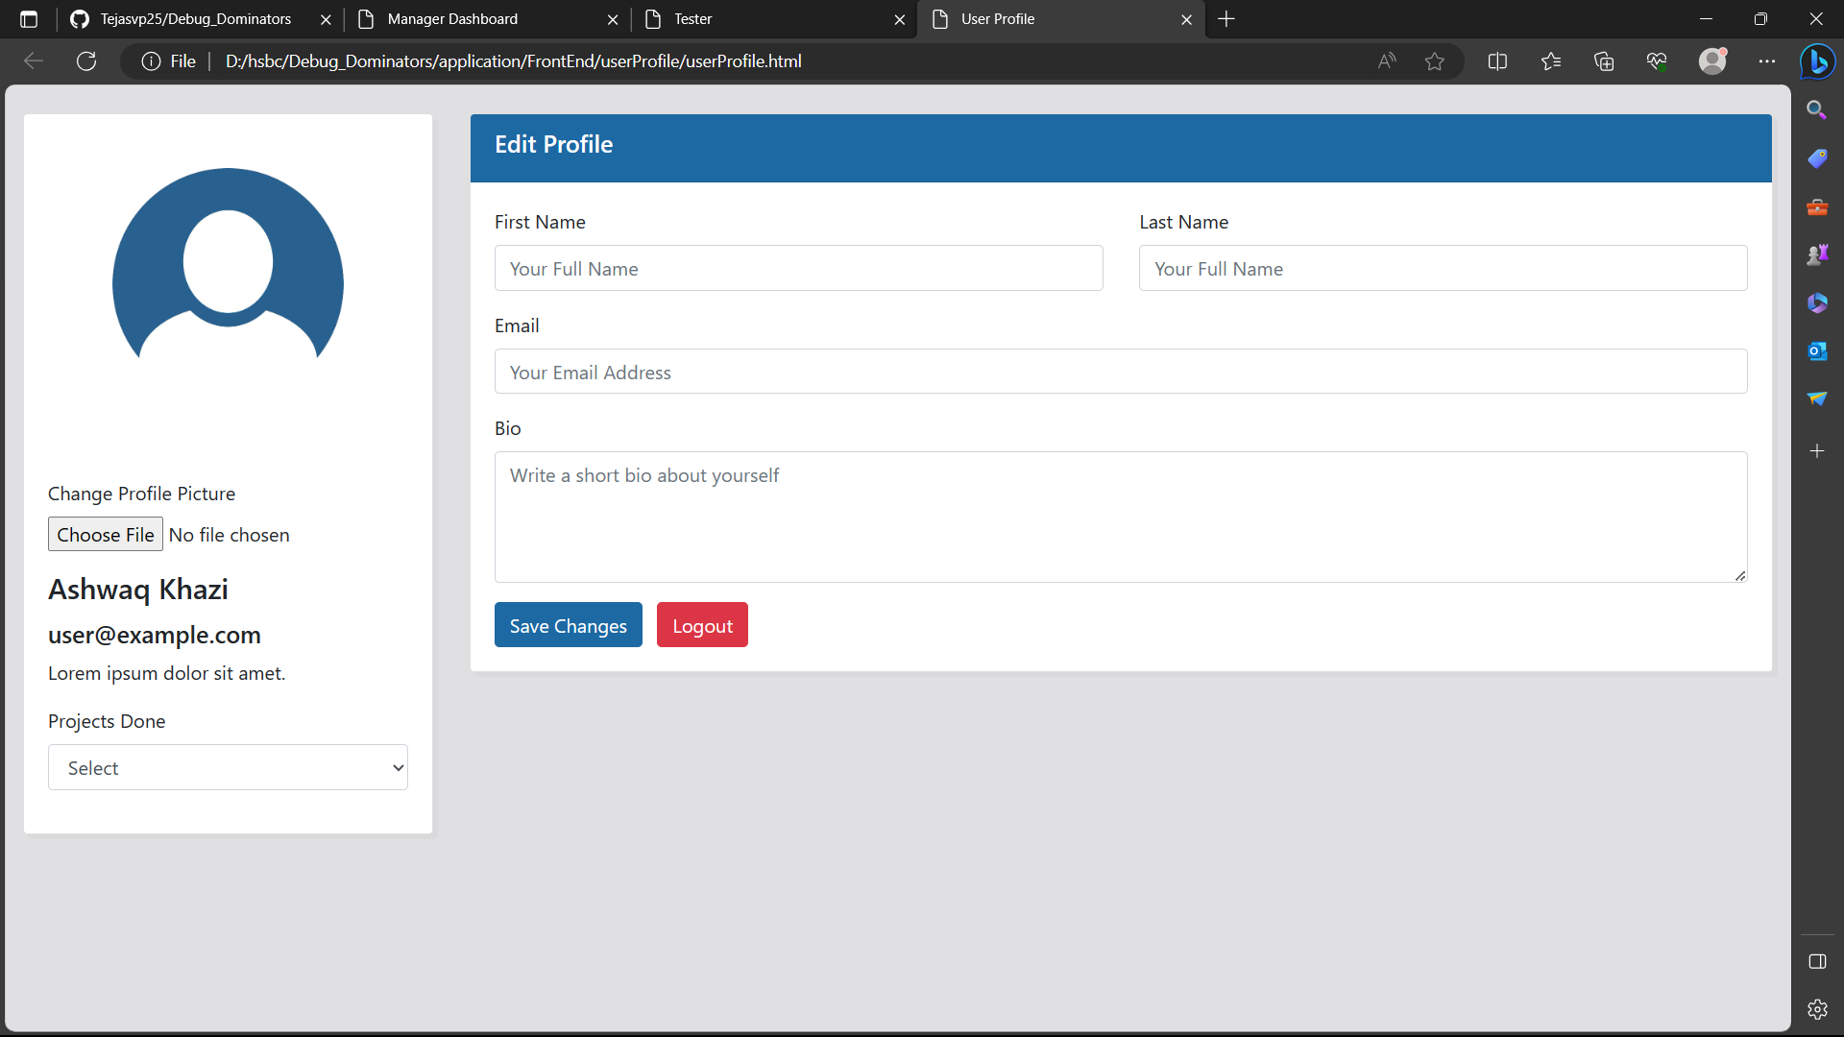

Slide 10
Highlights Of Learning Soft Skills:-
This project provided an excellent opportunity to develop and enhance various soft skills. Here are some key soft skills that WE learnt from participating in This project:
Communication Skills Problem-Solving and Critical Thinking
Adaptability Teamwork and Collaboration
Conflict Resolution Leadership Skills
Presentation Skills Time Management
Empathy and Cultural Awareness Creativity and Innovation
Responsibility and Accountability Feedback Acceptance

